Slide 1
Mini Project Presentation II
Sequence Learning,GRU and POS tagging using GRU

Slide 2
PART I:
Sequence Learning and RNN

Slide 3
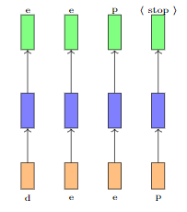
Sequence Learning
In feedforward and convolutional neural networks the size of the input is always fixed. For example, we feed fixed size (32×32) images to convolutional neural networks for image classification
Each input presented to the network is independent of the previous input
In many applications input size is not fixed and there is current input depends on previous input, this is called sequence learning problem

Slide 4
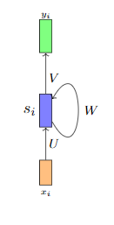
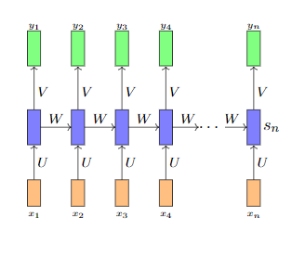
RNN
We can use RNN to model sequences

Slide 5
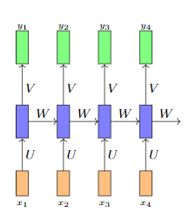
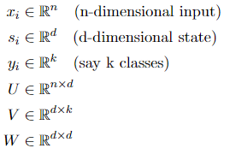

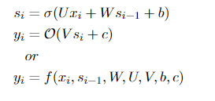
Training the RNN(BPTT)

Slide 6
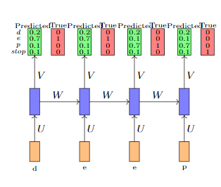
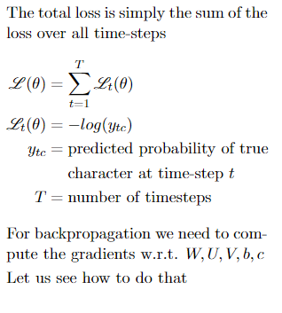
Back Propagation Through Time

Slide 7
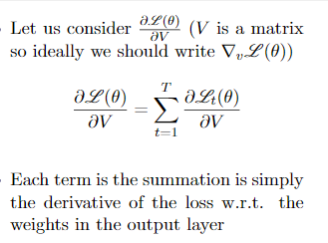
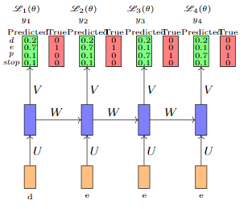
Back Propagation Through Time

Slide 8
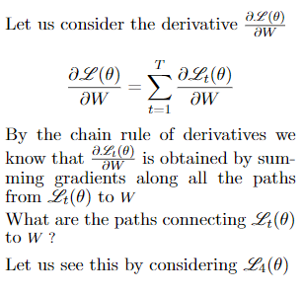
Back Propagation Through Time

Slide 9
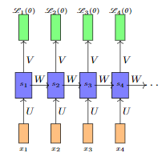
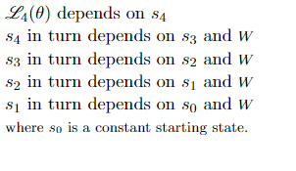
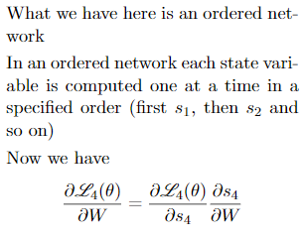
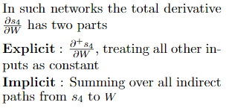
Back Propagation Through Time

Slide 10
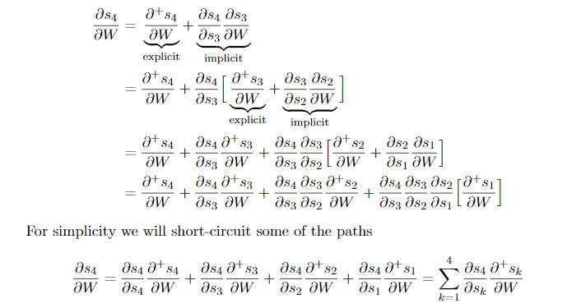
Back Propagation Through Time

Slide 11
PART II:
Part of Speech Tagging

Slide 12
Introduction
Process of marking up a word in a text (corpus) as corresponding to a particular part of speech
Words can represent more than one part of speech at different times, and because some parts of speech are complex or unspoken
9 parts of speech in English, However, there are clearly many more categories and sub-categories.
Problem is train a model which can learn the tags for each word depending on the context

Slide 13
PART II:
Gated Recurrent Unit(GRU)

Slide 14
GRU
GRU is a type of RNN and traditional RNN suffer from vanishing gradient problem
GRU can also be considered as a variation on the LSTM because both are designed similarly and, in some cases, produce equally excellent results
Instead of input gate , forget gate and output gate of LSTM, GRU contains only Reset and Update gate and the benefit is less no of computations

Slide 15
GRU
Update gate
  The update gate acts similar to the forget and input gate of an LSTM. It decides what information to throw away and what new information to add
Reset gate
  The reset gate is used to decide how much past information to forget

Slide 16
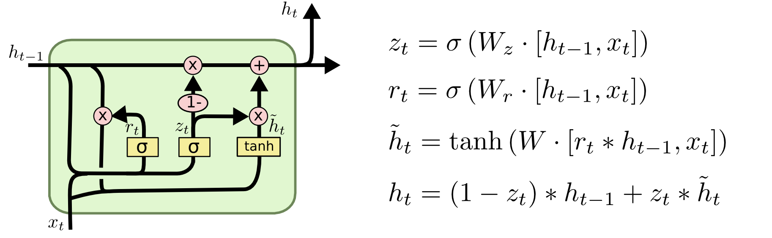
GRU Cell Structure

Slide 17
PART III:
Implementation results

Slide 18
Overview of Brown Data Set
Brown corpus is used as a dataset for POS Tagging
This dataset contains approx. 6000 sentences and 46 tags
Data set contains sentences which is in <word, tag> format
[[('The', 'DET'), ('Fulton', 'NOUN'), ('County', 'NOUN'), ('Grand', 'ADJ'), ('Jury', 'NOUN'), ('said', 'VERB'), ('Friday', 'NOUN'), ('an', 'DET'), ('investigation', 'NOUN'), ('of', 'ADP'), ("Atlanta's", 'NOUN'), ('recent', 'ADJ'), ('primary', 'NOUN'), ('election', 'NOUN'), ('produced', 'VERB'), ('``', '.'), ('no', 'DET'), ('evidence', 'NOUN'), ("''", '.'), ('that', 'ADP'), ('any', 'DET'), ('irregularities', 'NOUN'), ('took', 'VERB'), ('place', 'NOUN'), ('.', '.')]]

Slide 19
Implementation Results
Epoch: 1
Training Loss: 1.841435969640047, Accuracy: 94
Epoch: 2
Training Loss: 0.347639211668418, Accuracy: 94
Epoch: 3
Training Loss: 0.24737262725830078, Accuracy: 95
Epoch: 4
Training Loss: 0.24610881106211588, Accuracy: 95
Epoch: 5
Training Loss: 0.23579841355482736, Accuracy: 95
Epoch: 6
Training Loss: 0.1965977723399798, Accuracy: 95
Epoch: 7
Training Loss: 0.2089961608633017, Accuracy: 95
Epoch: 8
Training Loss: 0.15659580150475869, Accuracy: 96
Epoch: 9
Training Loss: 0.1675416609415641, Accuracy: 95
Epoch: 10
Training Loss: 0.16051566113646215, Accuracy: 95

Slide 20
Future Work
Trying out different mutations for standard GRU Cell and do performance comparison
Performance comparison using other POS Tagging models
Hyper Parameter Tuning using cross validation

Slide 21
Timeline of the project
Week I - II
Understanding the Parts of Speech tagging problem in detail
Week III -IV
Learning to use pytorch and torchtext
Preprocessing the dataset
Implementation of GRU architecture
Week V - VI
Implementation of POS tagger using different GRU cell implementations
Week VII
Project report submission

Slide 22
References
Empirical Evaluation of Gated Recurrent Neural Networks on Sequence Modeling paper https://www.researchgate.net/publication/269416998_Empirical_Evaluation_of_Gated_Recurrent_Neural_Networks_on_Sequence_Modeling
CS7015: Deep Learning Lecture by Mitesh M Khapra (IIT M) https://www.cse.iitm.ac.in/~miteshk/CS7015.html
Understanding GRU medium blog post
  Understanding GRU https://towardsdatascience.com/understanding-gru-networks-2ef37df6c9be

Slide 23
Thank You
Thank You

